Slide 1

Joining and Concatenating Datasets
2019

Slide 2
Why?
Why do we spend a Wednesday afternoon talking about this?

Slide 4
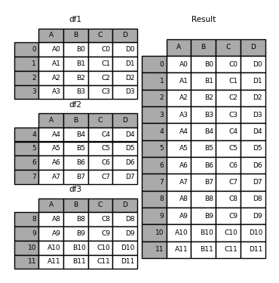
What joins and concats are useful for
So far we’ve seen mostly datasets that look like this
Notes:
5 min max.

Slide 5
What joins and concats are useful for
So far we’ve seen mostly datasets that look like this
Just a single place with all of our data
Notes:
5 min max.

Slide 6
What joins and concats are useful for
So far we’ve seen mostly datasets that look like this
Just a single place with all of our data
That’s not how the world works
Notes:
5 min max.

Slide 7
What joins and concats are useful for
In reality, our data will usually come from many different places
Notes:
5 min max.

Slide 8
What joins and concats are useful for
In reality, our data will usually come from many different places
A few reasons why:
Sometimes our data is just too big for a single file, so we will get many CSV’s with the same (hopefully) columns
Sometimes our data will come from a distributed system, where many applications handle different parts of the data and we need an overview (happens a lot in digital companies)
Sometimes we need to extend our data with more information than what we originally got (e.g. population of countries)
Notes:
5 min max.

Slide 9
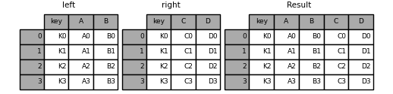
What joins and concats are useful for
Data will be split in two different ways, usually:
Split by row
Normalised
Notes:
5 min max.

Slide 10
So what are joins and concats useful for?
Notes:
5 min max.

Slide 11
What joins and concats are useful for
To fix that :)
CONCAT
MERGE or JOIN
Notes:
5 min max.

Slide 12
Concatenation

Slide 13
Concatenating datasets
We’ll look into
Basic syntax
Selecting an axis to concatenate
What happens when columns / index are mismatched?
Notes:
5 min max.

Slide 14
Basic syntax
pd.concat([df1, df2, df3])
Notes:
5 min max.

Slide 15
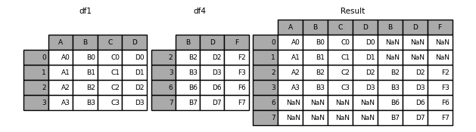
Selecting an axis
pd.concat([df1, df4], axis=1)
Notes:
5 min max.

Slide 16
What happens with missing data?
pd.concat([df1, df4], axis=1)
Notes:
5 min max.

Slide 17
An example

Slide 18
Joining datasets

Slide 19
Concatenating datasets
We’ll look into
Basic syntax of MERGE
What can we use as joining keys?
What happens with missing data?
Inner / outer / etc. joins
Notes:
5 min max.

Slide 20
Basic syntax for merge and join
pd.merge(df1, df2, on=”key”)
OR
df1.join(df2, on=”key”)
Notes:
5 min max.

Slide 21
What can we use for joining keys?
pd.merge(df1, df2, on=”key”) The joining key has the same name on both dataframes
pd.merge(df1, df2, left_on=”key1”, right_on=”key2”) The joining key has different names
pd.merge(df1, df2, left_on=”key1”, right_index=True) You can also join on the index of a dataframe
Notes:
5 min max.

Slide 22
What happens with missing data?
Let’s see an example:
https://colab.research.google.com/drive/15ckU7_DOFoxA5UJe0BeyFcc8pE8lxMhY
Notes:
5 min max.

